Slide 1
Concurrent Statements (Behavioral)
VHDL
Dr. Hakem Beitollahi
Computer Engineering Department
Elmo Sanat University
Notes:
The University of Adelaide, School of Computer Science
Chapter 2 — Instructions: Language of the Computer

Slide 2
Outline
Intro to Concurrent statements
Delay Types
When-else instruction
With-select-when instruction
Generics
Constants
VHDL Objects
— <number>

Slide 3
Introduction to Behavioral Modeling
The signal assignment statement
  a <= b;
  read as follows: a gets the value of b.
  The current value of signal b is assigned to signal a.
  This statement is executed whenever signal b changes value.
Introduce a nonzero delay value for the assignment
  a <= b after 10 ns;
  Read as follows: a gets the value of b when 10 nanoseconds of time have elapsed.
Both of the preceding statements are concurrent signal assignment statements.

Slide 4
Example: A simple AND gate
ENTITY and2 IS
PORT ( a, b : IN BIT;
PORT ( c : OUT BIT );
END and2;
ARCHITECTURE and2_behav OF and2 IS
BEGIN
c <= a AND b AFTER 5 ns;
END and2_behav;
The value of signal c may be assigned a new value after 5 nanoseconds whenever either a or b changes value.
The entity design unit describes the ports of the and2 gate.
  There are two inputs a and b, as well as one output c.
The architecture and2_behave for entity and2 contains one concurrent signal assignment statement

Slide 5
Delay Types

Slide 6
Delay Types (I)
Delay is created by scheduling a signal assignment for a future time
  Just for simulation (Not Synthesizable)
There are three main types of delay supported by VHDL
  Inertial delay
  Transport delay
  Delta delay
Input
Delay
Output

Slide 7
Delay Types (II)
Inertial Delay
  It absorbs pulses and wavelets of shorter duration than the specified delay
Output <= inertial not Input after 10 ns;
The Inertial delay is the default delay and the reserved word inertial can be omitted.
Input
Delay
Output
Output
Input
5
10
15
20
25
30
35
10 ns

Slide 8
Delay Types (III)
Transport Delay
  Must be explicitly specified by user
  Passes all input transitions with delay
-- TRANSPORT must be specified
Output <= transport not Input after 10 ns;
Input
Delay
Output
Output
Input
5
10
15
20
25
30
35
10 ns
10 ns

Slide 9
Delta Delay (IV)
Default signal assignment propagation delay if no delay is explicitly prescribed
  VHDL signal assignments do not take place immediately
  E.g.
Input
Dealy
Output
Output <= NOT Input;
-- Output assumes new value in one delta cycle
Output
Input
5
10
15
20
25
30
35

Slide 10
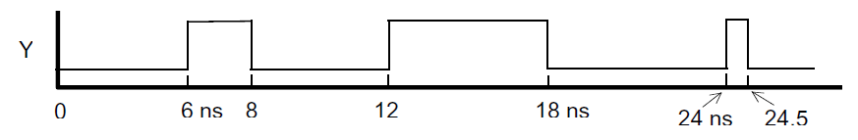
Check Yourself
Draw a waveform for the following signal assignment. For each requested statement, please determine the time.
  X <= Y after 5 ns;
  X <= transport Y after 5 ns;
  X<=Y;
— <number>

Slide 11
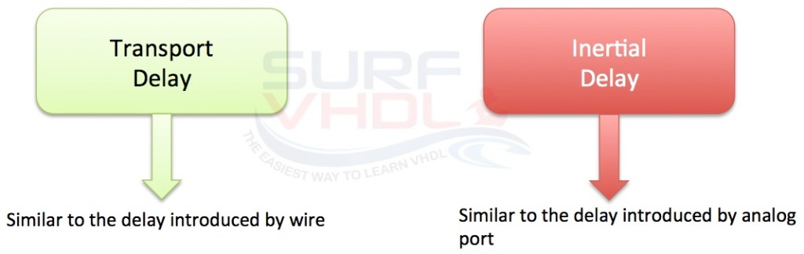
Inerial Delay vs. Transport delay
The transport delay is used to model the delay introduced by wire connection
The inertial delay models the delay introduced by an analog port, which means, it is analogous to the delay in devices that respond only if the signal value persists on their inputs for a given amount of time.
  It is useful in order to ignore input glitches whose duration is less than the port delay.
— <number>

Slide 12
Concurrent Statements

Slide 13
Concurrent Statements (I)
Three types of concurrent statements
used in dataflow descriptions
Boolean Equations
with-select-when
when-else
For concurrent
signal assignments
For selective
signal assignments
For conditional
signal assignments
Concurrent Conditional statements

Slide 14
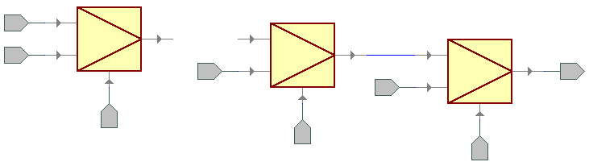
Concurrent Statements (II)
When – Else : (Conditional concurrent signal assignment)
target_signal <= value1 when condition1 else
value2 when condition2 else
. . .
valueN-1 when conditionN-1 else
valueN;
Value N
…
Value N-1
Target Signal
Value 2
Value 1
Condition N-1
Condition 2
Condition 1

Slide 15
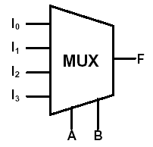
Concurrent Statements (III)
When-else Example: MUX
Entity mux is
Port(I₀, I₁, I₂, I₃ : in bit;
A, B : in bit;
F : out bit);
End mux;
Architecture mux_arch of mux is
Signal S: bit_vector(1 downto 0);
Begin
S<= A & B;
F <= I₀ when (s = "00") else
I₁ when (s = "01") else
I₂ when (s = "10") else
I₃;
end mux_arch;
We do not talk about logic gate, and or nand ect, we are describing the behavior of circuit using a high level description.

Slide 16
Unaffected signals
Value of the signal is not changed
VHDL 1993 only!
library IEEE;
use IEEE.std_logic_1164.all;
entity pr_encoder is
port (S0, S1,S2,S3: in std_logic;
Z : out std_logic_vector (1 downto 0));
end entity pr_encoder;
architecture behavioral of pr_encoder is
begin
Z <= “00” after 5 ns when S0 = ‘1’ else
“01” after 5 ns when S1 = ‘1’ else
unaffected when S2 = ‘1’ else
“11” after 5 ns when S3 = ‘1’ else
“00” after 5 ns;
end architecture behavioral;
The keyword unaffected indicates a choice where the signal is not given a new assignment.
This is roughly equivalent to the use of the null statement
— <number>

Slide 17
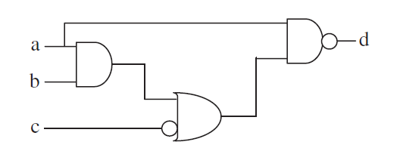
Check yourself
Using When-else statement, implement the following circuit
— <number>

Slide 18
Concurrent Statements (IV)
With –Select-When : (selected concurrent signal assignment)
with choice_expression select
target_signal <= expression1 when choices_1,
expression2 when choices_2,
. . .
expressionN when choices_N;
expression1
choices_1
expression2
choices_2
target_signal
expressionN
choices_N
choice expression

Slide 19
Concurrent Statements (V)
With-select-when Example: MUX
Entity mux is
Port(I₀, I₁, I₂, I₃ : in bit;
A, B : in bit;
F : out bit);
End mux;
Architecture mux_arch of mux is
Signal S: bit_vector(1 downto 0);
Begin
S<= A & B;
With S select
F<= I₀ when “00“,
I₁ when "01“,
I₂ when “10“,
I₃ when “11”;
end mux_arch;
We do not talk about logic gate, and or nand ect, we are describing the behavior of circuit using a high level description.

Slide 20
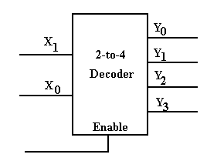
Check yourself
Using With-select-when statement, implement an active-high 2-4 decoder
— <number>

Slide 21
Concurrent Statements (Boolean equations)
Example: MUX
Entity mux is
Port(I₀, I₁, I₂, I₃ : in bit;
A, B : in bit;
F : out bit);
End
Architecture mux_arch of mux is
Begin
F<= ( not A and not B and I₀) or
( not A and B and I_{I}) or
( A and not B and I₂) or
( A and B and I₃)
end mux_arch;

Slide 22
Generics and Constants

Slide 23
Generics
If the model has a parameter, then it is defined using generics.
Generics are a means of passing specific information into an entity. They do not have a mode (direction):
generic (
gain : integer := 4;
time_delay : time := 10 ns );
Please note the way of assignment
entity entity_name is
generic (generic list);
port (port list); end entity_name;

Slide 24
Example
Define a parameterize value
entity AN2_GENERIC is
generic (DELAY: time := 10 ns);
port (A,B : in bit;
Z : out bit);
end AN2_GENERIC;
architecture BEH of AN2_GENERIC is
begin
Z <= A and B after DELAY;
end Beh;
Using the generic parameter

Slide 25
More about Generics
Generics are basically useful when you make multiple instances of a component.
  You can have different value of generic for each instance.
Example
  Instantiate a simple AND gate that has a generic declared for its Propagation Delay
  You can have different value of propagation delay for each instance.
  If the value of generic is not specified in instance then its default value is used which you can specify in the entity of this AND gate.
  More examples, when the structural model (components) is taught.

Slide 26
Constants
It is also possible to include model specific constants in the entity using the standard declaration of constants method
Improve the readability of the code
Allow for easy updating
Constants can be declared in any declarative region, and can be used within that region.
Their value cannot be changed once declared.
constant constant_name : type_name := constant_value;
constant delay1 : time := 5 ns;

Slide 27
Example
entity AN2_GENERIC is
port (A,B : in bit;
Z : out bit);
end AN2_GENERIC;
architecture BEH of AN2_GENERIC is
constant delay: time:= 10 ns;
begin
Z <= A and B after delay;
end Beh;
entity AN2_GENERIC is
port (A,B : in bit;
Z : out bit);
constant delay: time:= 10 ns;
end AN2_GENERIC;
architecture BEH of AN2_GENERIC is
begin
Z <= A and B after delay;
end Beh;
See location of definition

Slide 28
VHDL Objects
There are three types of objects in VHDL
  Constants
  Signals
  Variables
VHDL is strongly depends on types
  You cannot assign a value to a different type
    You should use “type conversion”

Slide 29
VHDL Objects (Signals I)
Signals are used for communication between components
Signals can be seen as real and physical wires
Signal assignment
  Signal_name <= value
Signals can be declared in
  Package declaration
  Architecture
  Block
  Subprograms (Functions and Procedures)

Slide 30
VHDL Objects (Signals II)
Signals must be declared outside a process
Declaration form
signal list_of_signal_names : type_name
[ := initial value ];
Declared in an architecture can be used
anywhere within that architecture

Slide 31
VHDL Objects (Variables I)
Variables are used only in processes and subprograms (functions and procedures)
All variable assignments take place immediately
Variables can be assigned by the assignment operator ":=".
Example:
  variable var1: bit_vector (7 downto 0);
  var1 := "01010011";
Variable is used when you want to create a serialized code, unlike the normal parallel code.

Slide 32
VHDL Objects (Variables II)
What are they for:
Local storage in processes, procedures, and functions
Declaring variables
variable list_of_variable_names : type_name
[ := initial value ];
Variables must be declared within the process in which they are used and are local to the process
  Also in subprograms and can be used only inside them

Slide 33
Variables vs. Signals
Variable assignment statement
variable_name := expression;
  expression is evaluated and the variable is instantaneously updated
  (no delay, not even delta delay)
Signal assignment statement
signal_name <= expression [after delay];
  expression is evaluated and the signal is scheduled to change after delay; if no delay is specified the signal is scheduled to be updated after a delta delay

Slide 34
Signals versus Variables
A key difference between signals and variables is the assignment delay
ARCHITECTURE signals of test is
SIGNAL a, b, c, out_1, out_2 : BIT;
BEGIN
PROCESS (clk,a, b, c)
BEGIN
if(clk’event and clk=‘1’) then
out_1 <= a NAND b;
out_2 <= out_1 XOR c;
end if;
END PROCESS;
END signals;
ARCHITECTURE variables of test is
SIGNAL a, b, c: BIT;
BEGIN
PROCESS (clk,a, b, c)
VARIABLE out_3, out_4 : BIT;
BEGIN
if(clk’event and clk=‘1’) then
out_3 := a NAND b;
out_4 := out_3 XOR c;
end if;
END PROCESS;
END variables;
CLK a b c out_1 out_2
0 0 1 1 x x
1 1 1 1 1 0
1+d 1 1 1 0 1
CLK a b c out_3 out_4
0 0 1 1 1 0
1 1 1 1 0 1

Slide 35
Signals vs. variables
variables:
  They are local;
  no delay;
  declared within process
signals:
  They are global (before begin);
  delay due to wire;
  declared before keyword begin
— <number>

Slide 36
Objects scope
VHDL limits the visibility of the objects, depending on where they are declared
The scope of the object is as follows
  Objects declared in a package are global to all entities that use that package
  Objects declared in an entity are global to all architectures that use that entity
  Objects declared in an architecture are available to all statements in that architecture
  Objects declared in a process are available to only that process
Scoping rules apply to constants, variables, and signals

